Slide 1
Turkey MCA
Technical Training

Slide 2
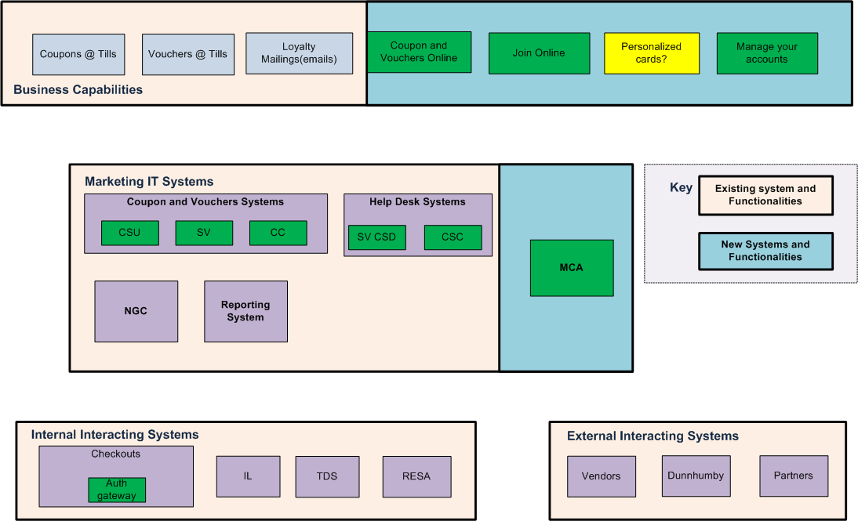
Systems and functionality

Slide 3
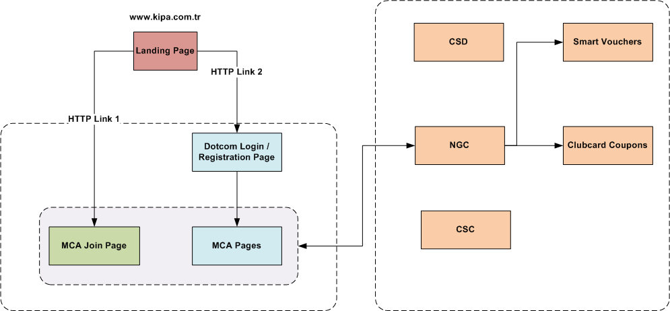
MCA Integration View
Please refer the Clubcard online design document for more information for MCA infrastructure setup and rules

Slide 4
MCA Environments
There are two Environments for MCA
PPE
MCA Web servers in DOTCOM Environment and Other Marketing components in UK PLC
This environment doesn’t have access to Store components
Live
MCA Web Servers in DOTCOM Environment and Other Marketing components in SITEL

Slide 5
Web Services Details
Web Services | Usage
NGCDecryptService
CustomerService
ClubcardService
SmartVoucherServices
ActivationServices
RewardService
CouponService
SVNInterfaces
PreferenceService
JoinLoyaltyService
NGCReportingService
UtilityService

